Slide 1
Yearly Sales and Profit
File created on: 3/1/2023 4:03:39 PM

Slide 2
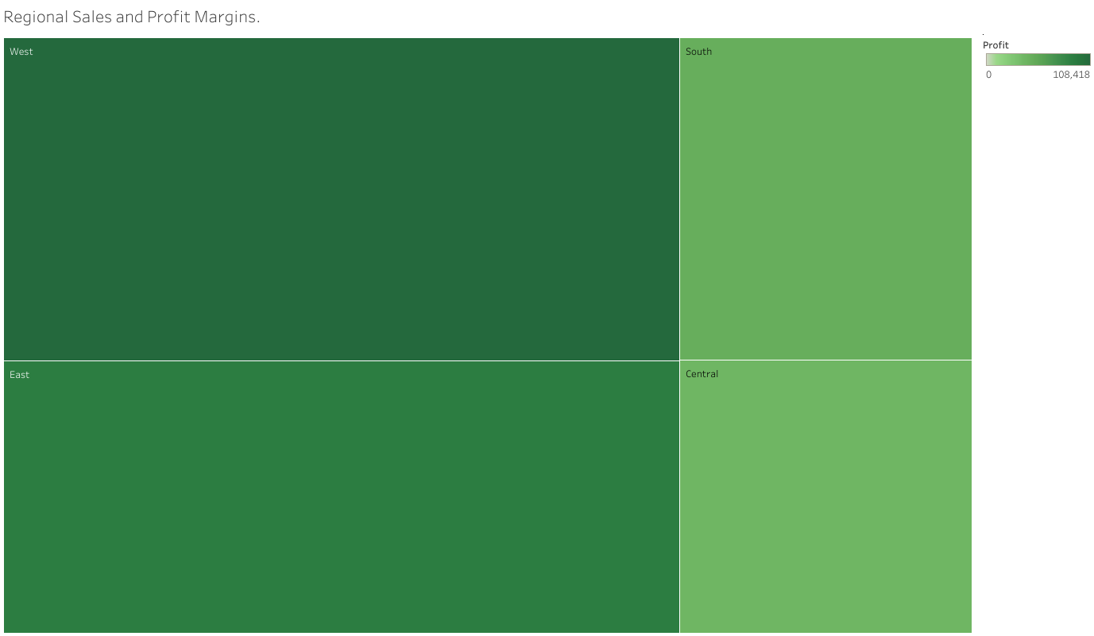

Slide 3
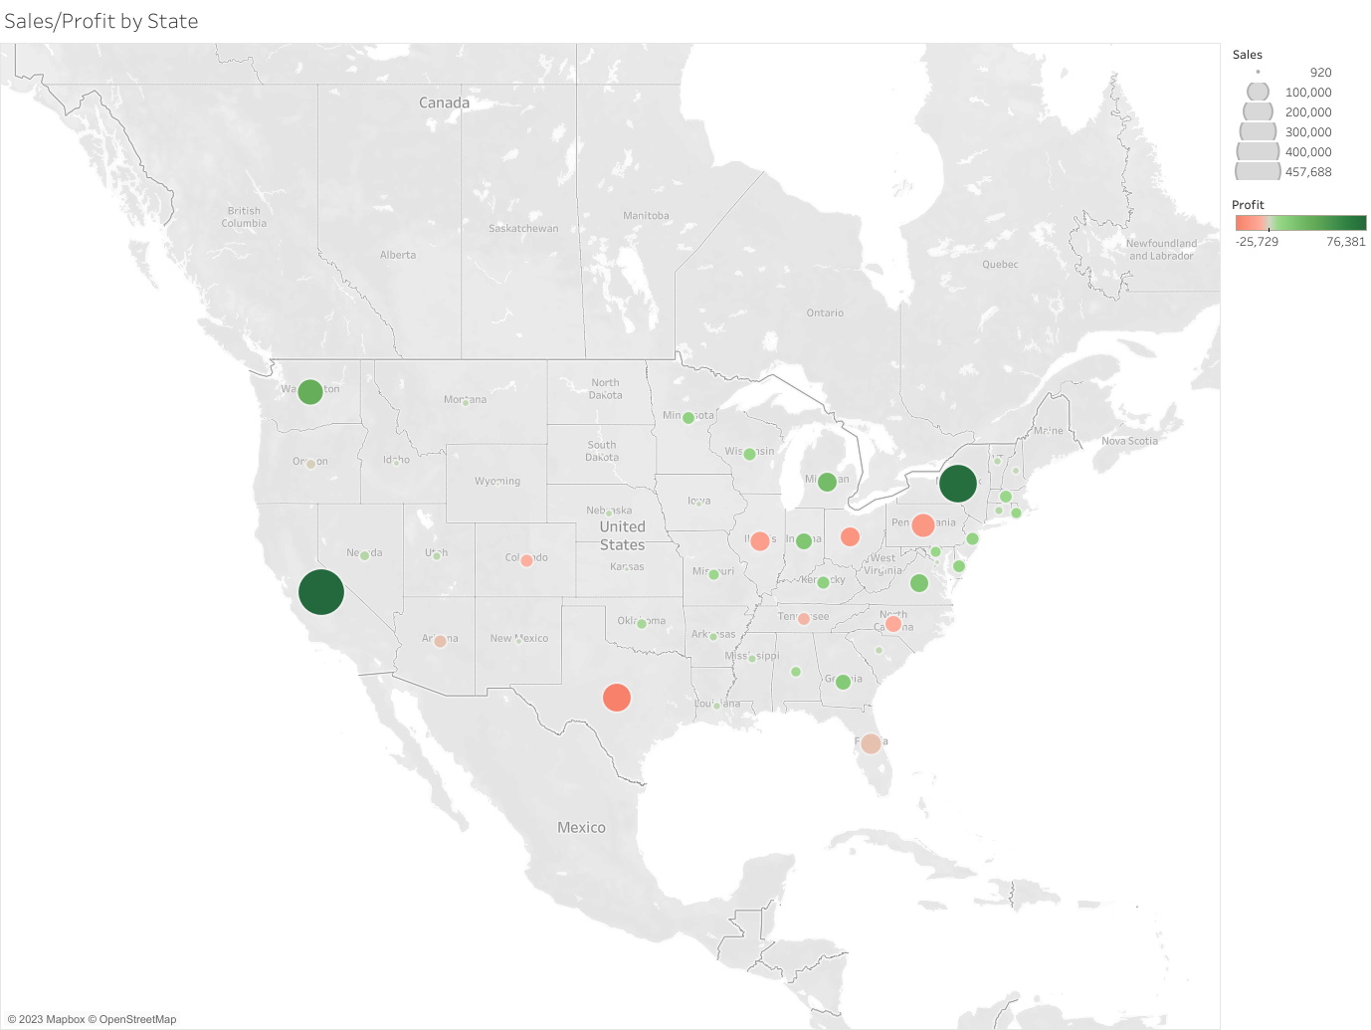

Slide 4
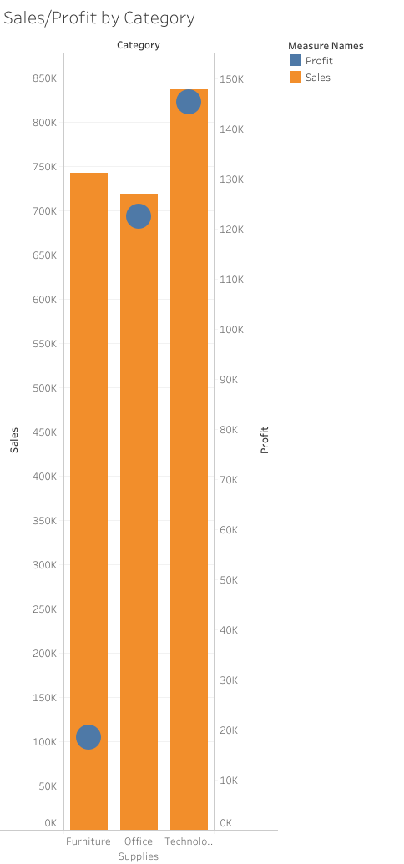

Slide 5
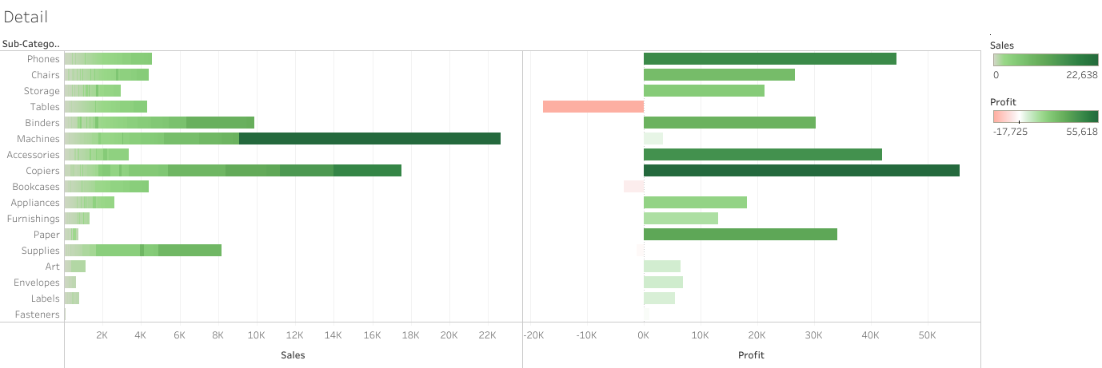

Slide 6
